Slide 1
Information Systems Theory and Practice
Task 1

Slide 2
Current Information System of Howard College
Only web portal and no mobile application
Ambiguous and unconcise output results
Poor performance
Slow responsiveness
Students area unable to participate in quizzes
No learning of students to access learning resources from the system

Slide 3
Information Systems in other Educational Organizations
Web and mobile, both applications are available
Results of the query or search in the portal are clear and concise
24/7 access
Excellent performance
Fast response time
Students can access quizzes in real time
Multiple learning resources can be access via portal
Students can learn to use the portal through the learning manual and guide

Slide 4
Example of Information System for educational organizations
Web Portal of National University of Sciences and Technology- Pakistan

Slide 5
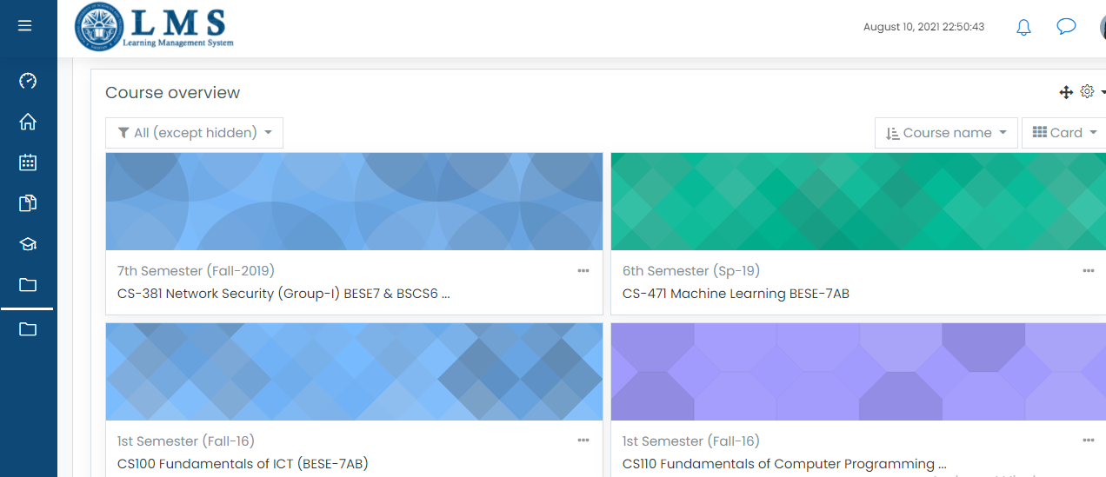
Dashboard

Slide 6
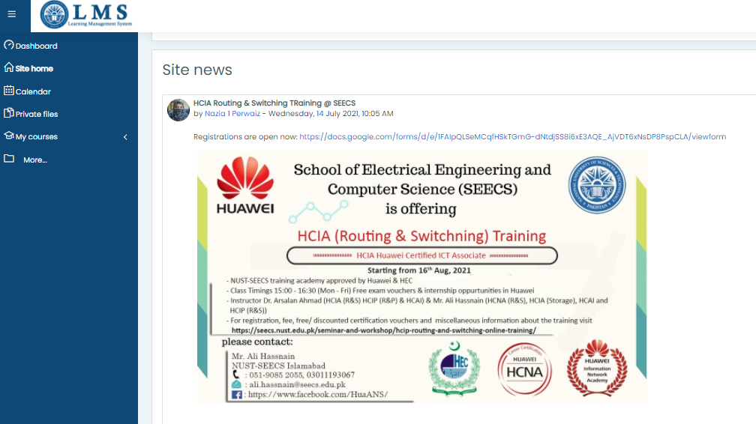
Site News

Slide 7
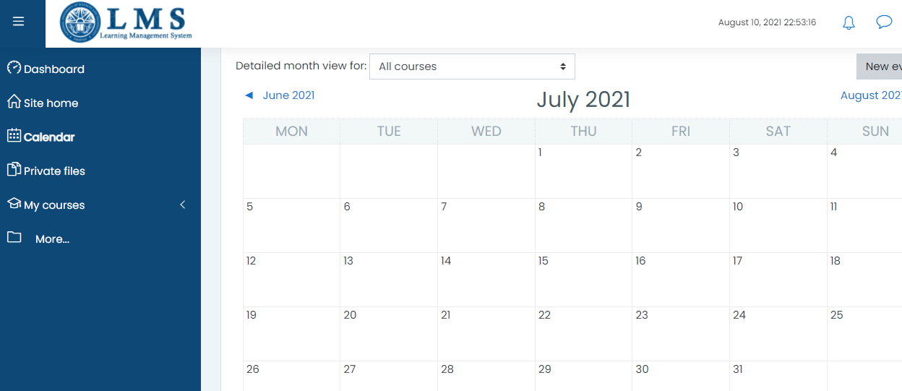
Student Calendar

Slide 8
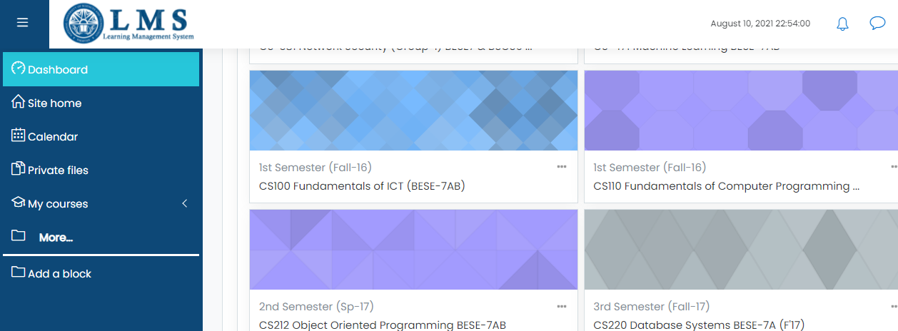
Easy Navigation

Slide 9
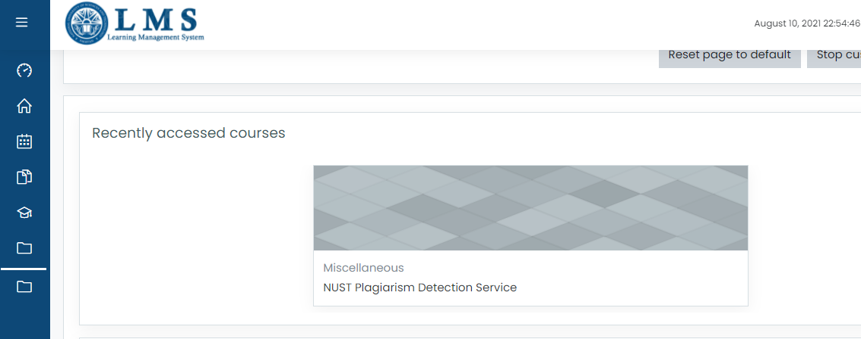
Plagiarism Detection Service

Slide 10
Effectiveness of Current System
Current system is ineffective and inefficient
Does not fulfil learning purpose for students
Hard to understand and use
No proper training given to students to use it
Slow and poor performance

Slide 11
Information System Needs
Business Organization

Slide 12
New Services on Portal
Information system analyzes independent processes
Enables organized work activities
Assists the business organization with understanding of development and selling of services

Slide 13
Information Storage
Keeps a log of activities by students
Stores operational data, revision history, documents and communication records
Maintains database

Slide 14
Simplified Decision Making
Simplified delivery of outputs
Time saving
Provides with required information
Helps in informed decision making by the students

Slide 15
Better Communication
Provides platform for better communication between teachers and students
Files and folders can be uploaded by students
Teachers can review the uploaded work
Flow of information is organized

Slide 16
Resources
Comodo (2018). Reasons Why Information Systems Are Important for Business Today. [online] Comodo.com. Available at: https://one.comodo.com/blog/msp/why-business-information-systems-are-important.php.
‌lms.nust.edu.pk. (n.d.). NUST - LMS Portal: Log in to the site. [online] Available at: https://lms.nust.edu.pk/portal/my/

